Slide 1
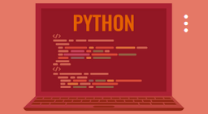

CWCT 140
Professor David Lieberman
dlieberman@ivytech.edu

Slide 2
Agenda
Netacad Python Sandbox
Print – escape characters
Input
Data Types
Operators
Variables
Shortcut Operators
Type Casting
Strings
Programming Exercise #1

Slide 3
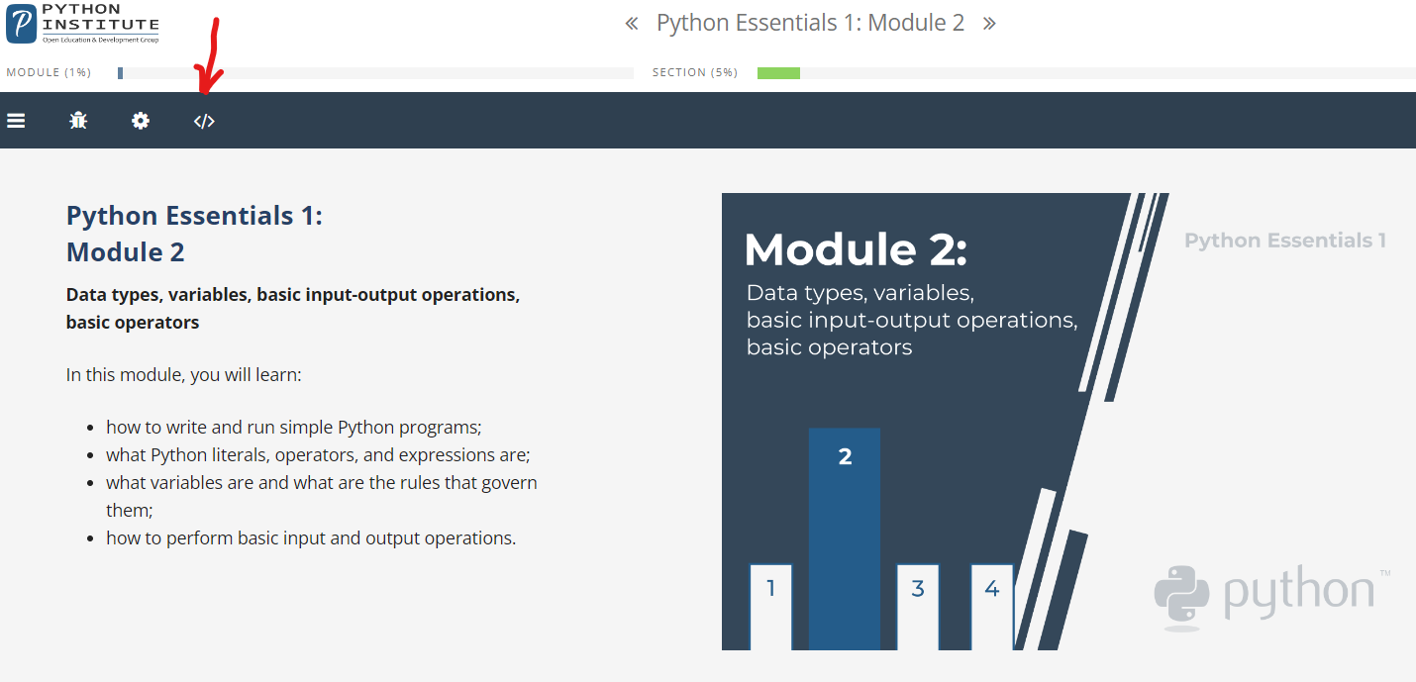
Netacad Sandbox

Slide 4
Print
\n New Line
\t Tab
\\ A “backslash”
End=“”
Sep=“-”
0x123
0o123

Slide 5
Data Types
int
float
string
Boolean (True and False)
Lists

Slide 6
Operators
+ - / *
** Exponentiation
// Integer division
% Modulus

Slide 7
Order of Operations
* or /
+ or -
Mod: Left side binding 9 % 6 % 2
Exp: Right side binding 2 ** 2 ** 3

Slide 8
Variables
Must begin with a letter
Cannot contain a space
Comes into existence by assigning a value to it. You don't need to declare it in any special way.
If you assign any value to a nonexistent variable, the variable will be automatically created
You're not allowed to use a variable which doesn't exist

Slide 9
Shortcut Operators
+=
*=
/=
%=
**=

Slide 10
Type Casting
Int(arg) Attempts to convert argument to an integer
Float(arg) Attempts to convert argument to a float
Can be combined with an input statement

Slide 11
Input
myName = input(“Name: ”)
myInt = int(input(“Number: ”))
myNum = float(input(“Number: ”))

Slide 12
String Operators
Concatenation (+)
Replication (*)
Str() – Type conversion
print("+" + 10 * "-" + "+")
print(("|" + " " * 10 + "|\n") * 5, end="")
print("+" + 10 * "-" + "+")
print("Answer = " + 2)
print("Answer = ", 2)

Slide 13
Programming Assignment
With all program submissions you need to include screenshots illustrating your programs ran successfully.
All program submissions require a header comment containing your name, course, date, program name, and a description of the program.

Slide 14
Assignment #1
Prompt the user for the amount of the meal (e.g. $32.95).
Compute the tax on the restaurant bill. The tax should be 6.75 percent of the meal cost.
Prompt the user for the tip amount (Suggesting a value equal to 18 percent of the total)
Display the meal cost, tax amount, tip amount, and total bill on the screen.

